Slide 1

iCare Guide for Ambulance Claims Processing Overview
a Humana Inc, subsidiary

Slide 2
Disclaimer:
This information is provided as a courtesy from iCare to assist you with claims submission and billing. This does not replace Forward Health and CMS Guidelines. iCare relies upon Forward Health and CMS for payment rules and regulations for claim submission.

Slide 3
Medicare Ambulance Services
Medicare covers ground ambulance transportation when a need to be transported to a hospital, critical access hospital, or skilled nursing facility for medically necessary services, and transportation in any other vehicle could endanger health.
Medicare may pay for emergency ambulance transportation in an airplane or helicopter to a hospital if there is a need for immediate and rapid ambulance transportation that ground transportation can’t provide. In some cases, Medicare may pay for limited, medically necessary, nonemergency ambulance transportation if there is a written order from a doctor stating that ambulance transportation is medically necessary.

Slide 4
Medicaid Ambulance Services
ForwardHealth covers ambulance transportation only for enrolled members who are going to and from a covered service.
  More information can be found at https://www.forwardhealth.wi.gov/WIPortal/Subsystem/KW/Display.aspx?ia=1&p=1&sa=2&s=2&c=61

Slide 5

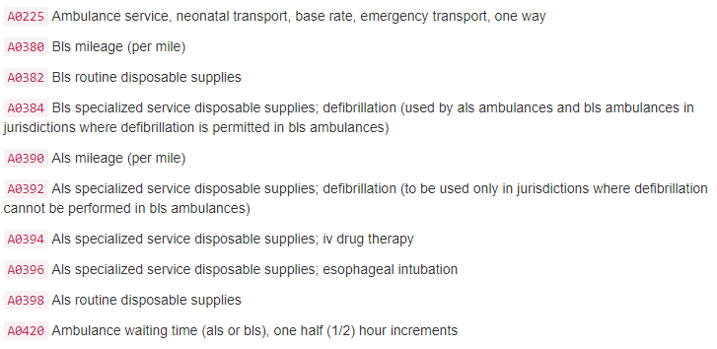
Ambulance HCPCS codes and Definitions

Slide 6
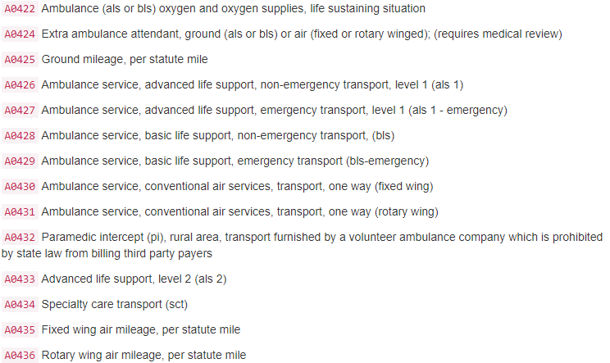
Ambulance HCPCS codes and Definitions

Slide 7
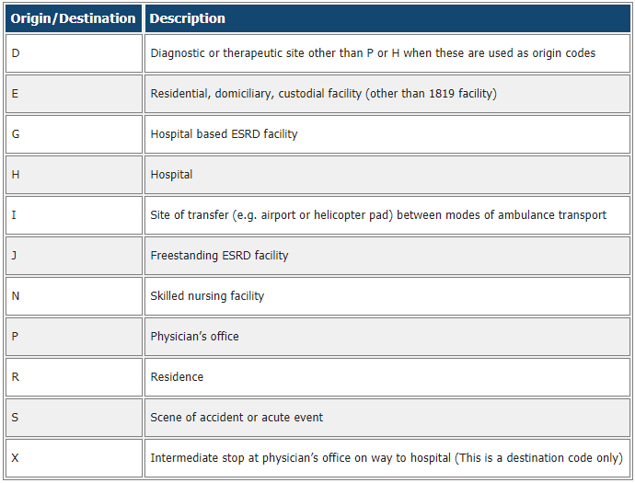
Ambulance Services – Modifiers

Slide 8
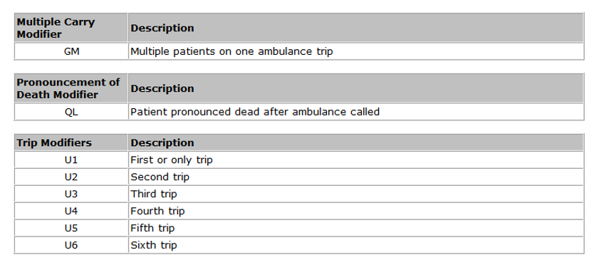
Ambulance Services - Modifiers

Slide 9
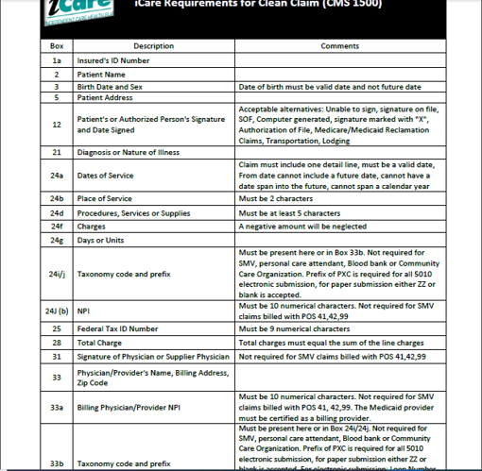
Clean Claim Guidelines – HCFA

Slide 10
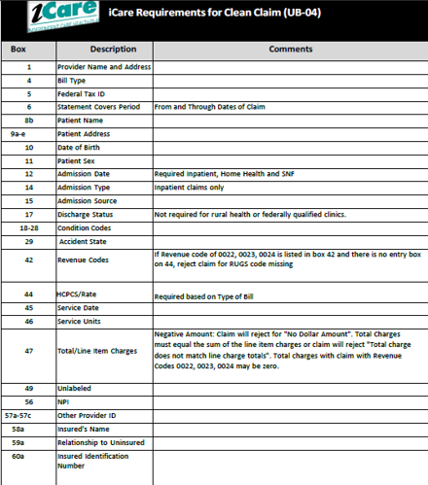
Clean Claim Guidelines – UB04

Slide 11
Claim Filing Limits
Timely filing limits for all providers is 120 days from the date of service, unless otherwise agreed upon and included in the Provider’s service agreement with iCare.
Providers are to submit all claims for services rendered where iCare Medicare is primary or iCare Medicaid is primary according to the terms of the contract. Timely filing limits apply to initial claim submissions, resubmissions and corrected claims.

Slide 12
Claims Submission
Medicare/Medicaid Covered Services
Independent Care Health Plan
P.O. Box 280
Glen Burnie, MD 21060-0280
Long-Term Care Services
Independent Care Health Plan
P.O. Box 670
Glen Burnie, MD 21060-0670
iCare is partner with the claims clearinghouse, SSI Claimsnet, to allow electronic claims submission.
To register with SSI Claimsnet for electronic claims submission via the Internet, click here. Select iCare in the payer drop down box on the registration form to avoid paying any set-up or submission fees for your iCare claims through SSI Claimsnet

Slide 13
Electronic Funds Transfer (EFT) and Electronic Remittance Advice (ERA)
Electronic Funds Transfer (EFT) EnrollmentiCare has joined the InstaMed Network to deliver your payments as free electronic remittance advice (ERA) and electronic funds transfer (EFT).
Sign up now to receive iCare payments as direct deposits!
ERA/EFT is a convenient, paperless and secure way to receive claims payments. Funds are deposited directly into your designated bank account and include the TRN Reassociation Trace Number in accordance with CAQH CORE Phase III Operating Rules for HIPAA standard transactions. Additional benefits include:
Accelerated access to funds with direct deposit into your existing bank account
Reduced administrative costs by eliminating paper checks and remittances
No disruption to your current workflow — ERAs can also be routed to your existing clearinghouse
You have two simple options to register for free ERA/EFT from InstaMed:
Online: visit www.instamed.com/eraeft
Phone: call us at (866) 945-7990 to speak with a live agent

Slide 14
iCare Provider Portal Access
Your time is valuable. iCare's Provider Portal allows you to view prior authorizations, service requests, verify eligibility and view claim information for the iCare members you serve.
Getting Started
Registration can be completed with information already at your disposal using your TIN (Tax ID Number), NPI and most recent check number. Use the Facility/Group name as listed on your Explanation of Payment. iCare can also generate a one-time PIN, you can request a one-time PIN via the request button below. If you have checks with more than 20 claims processed your will need to request a PIN to register.
If you do not receive your PIN, please contact iCare at ProviderRelationsSpecialist@iCareHealthPlan.org for additional assistance.
If an organization chooses to assign roles for the employees, the Office Manager will need to create a user account for the users within your organization. Office Managers can set up additional users individually and invite them to register or you can create user accounts in bulk via spreadsheet upload.
The iCare Portal User Guide provides step by step instructions for registration and outlines functionalities. If you have any questions, please contact ProviderOutreach@iCareHealthPlan.org or ProviderRelationsSpecialist@iCareHealthPlan.org
Use care when entering your password in the Provider Portal. If the incorrect password is attempted 3 times, your account will be locked. If you are not able to reset your own password or retrieve your forgotten password, email ProviderOutreach@iCareHealthPlan.org or ProviderRelationsSpecialist@iCareHealthPlan.org. Include your Username and your password will be reset within 24 hours.

Slide 15
Frequently Asked Questions
When Medicare is primary which HCPCS code is used for ground ambulance services?
  A0425 – BLS mileage (per mile) or ALS mileage (per mile)
When Medicare is primary, should the provider submit claims using the trip modifiers for multiple transports on the same day?
  No, Medicare will only submit using providers and suppliers must report an origin and destination modifier for each ambulance trip provided in HCPCS/Rates.
Will iCare cover Hospital to Hospital transport.
  Yes
Multiple ambulance providers respond to a 911 call, will iCare pay the ambulance provider if there was not provide the transport.
  No, payment is made only if you actually transport the member to the nearest hospital
Will iCare pay the ambulance provider if Member is pronounced dead on arrival.
  Yes, payment your BLS base rate; No mileage or rural adjustment; and Use QL modifier, “Patient pronounced dead after ambulance called,” on claim .

Slide 16
GENERAL CONTACT/INDIVIDUAL DEPARTMENT PHONE AND FAX NUMBERS
MAIN NUMBER
414-223-4847 or 800-777-4376
Claims/Appeals/Reconsiderations
Local: 414-231-1029
Fax: 414-231-1094
Out of Area: 877-333-6820
Email: department-providerservices@icarehealthplan.org
Eligibility and Provider Services
Local: 414-231-1029
Fax: 414-231-1094
Out of Area: 877-333-6820
Prior Authorization
Local: 414-299-5539
Out of Area: 855-839-1032
Fax: 414-231-1026
Provider Contracting
414-225-4741
Fax: 414-272-5618

