Slide 1
iCare Guide for Hearing Claims Processing Overview
a Humana Inc, subsidiary

Slide 2
Disclaimer:
This information is provided as a courtesy from iCare to assist you with claims submission and billing. This does not replace Forward Health and CMS Guidelines. iCare relies upon Forward Health and CMS for payment rules and regulations for claim submission.

Slide 3
Services Requiring Prior Authorization
Aural Rehabilitation
Use of Residual Hearing
Speech Reading or Lip Reading
Compensation Techniques
Gestural Communication Techniques
Purchase of Any Special Modifications to Hearing Instruments
Purchase or Rental of All Hearing Instruments
Replacement of Any Hearing Instruments Not Subject to the Terms of the Volume Purchase Contract
SLP Services
Unlisted Otorhinolaryngological Service or Procedure

Slide 4
Medicare Plan
New Hearing Benefit – 2024
0 copay for routine hearing exams up to 1 every year.
$0 copay for follow-up provider visits up to unlimited per year.
$0 copay for each Advanced level hearing aid up to 1 per ear every 3 years.
Note: Includes 80 batteries per aid and 3 year warranty.
Unlimited follow-up provider visits during first year following TruHearing hearing aid purchase

Slide 5
Medicaid
iCare Medicaid
Hearing Services – When Medically Necessary
Hearing Exams/Aids
Covered benefit when the services are provided by an approved provider when the services are arranged through a Care Coordinator or Case Manager.
Below is a sample of covered devices, please refer to ForwardHealth on line manual for complete and up to date list
Bone Anchor Hearing Device
L8690
L8692
L7510
L8691
V5266

Slide 6
Medicaid Cont.
Below is a sample of covered devices, please refer to ForwardHealth on line manual for complete and up to date list
Bone Anchor Hearing Device
L8690
L8692
L7510
L8691
V5266
Cochlear Implants
L7510 L8621
L8614 L8622
L8615 L8623
L8616 L8624
L8625
L8617 L8627
L8618 L8628
L8619 L8629

Slide 7
Medicaid Cont.
Replacement Parts for Cochlear Implants
Reimbursable with CPT L7510
Replacement Part Life Expectancy
Battery Charge Kit 1 Per Every 3 Years
Cochlear Auxiliary Cable Adapter 1 Per Every 3 Years
Cochlear Belt Clip 1 Per Every 3 Years
Cochlear Harness Extension Adapter 1 Per Every 3 Years
Cochlear Signal Checker 1 Per Every 3 Years
Microphone Cover 1 Per Year
Pouch 1 Per Year

Slide 8
Medicaid Cont.
Modifier | Description
LT | Left side
RR* | Rental
RT | Right side
*The maximum allowable fee for all rentals is $27.34 per 30-day period. All rented hearing instruments require PA. Wisconsin Medicaid and BadgerCare Plus do not reimburse providers for dispensing fees for rental hearing instruments.

Slide 9
Family Care Partnership
Hearing Services are included in the Family Care Partnership Benefit Package
Hearing Aids
Batteries
Accessories
Assistive Listening Devices
Repair and Maintenance of Hearing Aids
Repair and Maintenance of Assistive Listening Devices

Slide 10
Covered Audiology Services
Based on ForwardHealth for BadgerCare Plus and Medicaid
NOTE: There is a 5 year life expectancy on hearing aids for adults and 3 year life expectancy on hearing aids for children ages 17 and younger.

Slide 11
Contracted Hearing Aid Pricing
Because the Fee Schedule for V codes is SYSMAN (plan determined rate), please submit the Hearing Aid Manufacturer/Style and Model(s)
Submit on your Prior Authorization request
Or submit on Claim (may include invoice) for reimbursement per topic #2996
If the Manufacturer/Style and Model(s) is not submitted, the claim will be denied needing further information.

Slide 12
Accessories that should be billed under V5267
Air Conduction Receiver
Body and CROS Hearing Instrument Cords
Bone Conduction Receiver and Headband
Direct Audio Input Boot/Cords
Harness for Body Aid (Children)
Limitations apply and listed in ForwardHealth’s Online Handbook under topic #2980

Slide 13
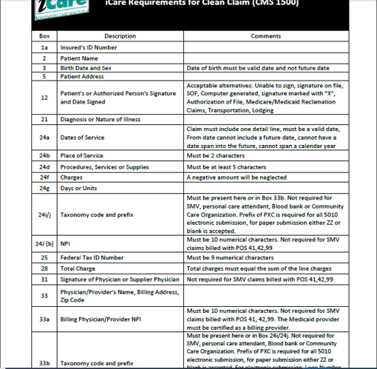
Clean Claim Guidelines - HCFA

Slide 14
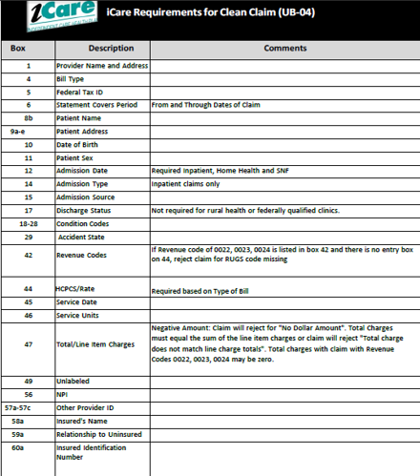
Clean Claim Guidelines – UB04

Slide 15
Claims Filing Limits
Timely filing limits for all providers is 120 days from the date of service, unless otherwise agreed upon and included in the Provider’s service agreement with iCare.
Providers are to submit all claims for services rendered where iCare Medicare is primary or iCare Medicaid is primary according to the terms of the contract. Timely filing limits apply to initial claim submissions, resubmissions and corrected claims.

Slide 16
Claims Submission
Medicare/Medicaid Covered Services
Independent Care Health Plan
P.O. Box 280
Glen Burnie, MD 21060-0280
Long-Term Care Services
Independent Care Health Plan
P.O. Box 670
Glen Burnie, MD 21060-0670
iCare is partner with the claims clearinghouse, SSI Claimsnet, to allow electronic claims submission.
To register with SSI Claimsnet for electronic claims submission via the Internet, click here. Select iCare in the payer drop down box on the registration form to avoid paying any set-up or submission fees for your iCare claims through SSI Claimsnet

Slide 17
Electronic Funds Transfer (EFT) and Electronic Remittance Advice (ERA)
Electronic Funds Transfer (EFT) EnrollmentiCare has joined the InstaMed Network to deliver your payments as free electronic remittance advice (ERA) and electronic funds transfer (EFT). Sign up now to receive iCare payments as direct deposits! ERA/EFT is a convenient, paperless and secure way to receive claims payments. Funds are deposited directly into your designated bank account and include the TRN Reassociation Trace Number in accordance with CAQH CORE Phase III Operating Rules for HIPAA standard transactions. Additional benefits include:
Accelerated access to funds with direct deposit into your existing bank account
Reduced administrative costs by eliminating paper checks and remittances
No disruption to your current workflow — ERAs can also be routed to your existing clearinghouse
You have two simple options to register for free ERA/EFT from InstaMed:
Online: visit www.instamed.com/eraeft
Phone: call us at (866) 945-7990 to speak with a live agent

Slide 18
iCare Provider Portal Access
Your time is valuable. iCare's Provider Portal allows you to view prior authorizations, service requests, verify eligibility and view claim information for the iCare members you serve.
Getting Started
Registration can be completed with information already at your disposal using your TIN (Tax ID Number), NPI and most recent check number. Use the Facility/Group name as listed on your Explanation of Payment. iCare can also generate a one-time PIN, you can request a one-time PIN via the request button below. If you have checks with more than 20 claims processed your will need to request a PIN to register.
If you do not receive your PIN, please contact iCare at ProviderRelationsSpecialist@iCareHealthPlan.org for additional assistance.
If an organization chooses to assign roles for the employees, the Office Manager will need to create a user account for the users within your organization. Office Managers can set up additional users individually and invite them to register or you can create user accounts in bulk via spreadsheet upload.
The iCare Portal User Guide provides step by step instructions for registration and outlines functionalities. If you have any questions, please contact ProviderOutreach@iCareHealthPlan.org or ProviderRelationsSpecialist@iCareHealthPlan.org
Use care when entering your password in the Provider Portal. If the incorrect password is attempted 3 times, your account will be locked. If you are not able to reset your own password or retrieve your forgotten password, email ProviderOutreach@iCareHealthPlan.org or ProviderRelationsSpecialist@iCareHealthPlan.org. Include your Username and your password will be reset within 24 hours.

Slide 19
GENERAL CONTACT/INDIVIDUAL DEPARTMENT PHONE AND FAX NUMBERS
MAIN NUMBER
414-223-4847 or 800-777-4376
Claims/Appeals/Reconsiderations
Local: 414-231-1029
Fax: 414-231-1094
Out of Area: 877-333-6820
Email: department-providerservices@icarehealthplan.org
Eligibility and Provider Services
Local: 414-231-1029
Fax: 414-231-1094
Out of Area: 877-333-6820
Prior Authorization
Local: 414-299-5539
Out of Area: 855-839-1032
Fax: 414-231-1026
Provider Contracting
414-225-4741
Fax: 414-272-5618

