Slide 1

a Humana Inc, subsidiary
iCare Guide for Hospice
CLAIMS PROCESSING OVERVIEW

Slide 2
Disclaimer:
This information is provided as a courtesy from iCare to assist you with claims submission and billing. This does not replace Forward Health and CMS Guidelines. iCare relies upon Forward Health and CMS for payment rules and regulations for claim submission.

Slide 3
Hopsice Services – Prior Authorization
Hospice services must be requested in 60 day increments
Ongoing services must be requested and will continue to require an updated signed physician’s order/plan of care. For ongoing services, all PA requests are required to be submitted within 14 days after the expiration date of the previous authorization.
iCare will not retro authorize any services submitted after the 14th day.
Please see our website for procedure specific list and forms
https://www.icarehealthplan.org/Prior-Authorization.htm

Slide 4
Medicaid Services
Hospice Services are provided to members based on the following categories of hospice care
  Routine Care, with per diem rate for less than 8 hours of care per day
  Continuous Care, with an hourly rate for 8 to 24 hours of care per day
  Inpatient Respite Care, hospital or Skilled Nursing Facility (SNF) meeting SNF staffing, hourly and environmental requirements
  General Inpatient Care, Hospital or SNF
  Other Functions; PT, OT, SLP DME/DMS Drugs for pain relief or symptom control
  See ForwardHealth On-Line Handbook for further information

Slide 5
Medicaid Services Cont.
Hospice Services when in SNF
  The Hospice reimburses the SNF for Medicaid SSI Members SNF Room and Board
  iCare reimburses the SNF for Medicaid Family Care Partnership members SNF Room and Board
    Submit claims with Rev Code 169 to be reimbursed 95% of RUG rate
  See ForwardHealth On-Line Handbook for further information

Slide 6
Medicaid Service Cont.
iCare is requiring providers to submit the Notification of Hospice Benefit Election Form F-01008 when requesting prior authorization (PA) for hospice services. If the F-01008 form is not included, the PA will be denied for lack of information.
Per ForwardHealth (Update 2015-64), MCOs will require their providers to submit to the MCO Form F-01008 Notification of Hospice Benefit Election. The MCO will forward the form to DXC at the address indicated on the form. DXC will put a hospice lock-in segment on file for the member to allow Code T2042 to price for encounters in the same manner as it does fee-for-service.
The form can be found on the DHS website: https://www.dhs.wisconsin.gov/library/f-01008.htm

Slide 7
Medicare Services
Services covered by the iCare Medicare plan include Hospice Care
The first election is for a 90-day period. An individual may elect to received coverage for two 90-day periods, and an unlimited number of 60-day periods.
Hospice Notice of Election statement is required to be filed within 5 calendar days after hospice election to CMS

Slide 8
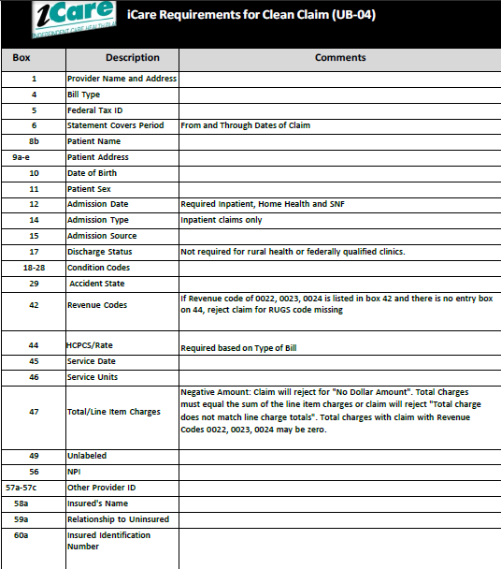
Clean Claim Guidelines – UB04

Slide 9
Claims Filing Limits
Timely filing limits for all providers is 120 days from the date of service, unless otherwise agreed upon and included in the Provider’s service agreement with iCare.
Providers are to submit all claims for services rendered where iCare Medicare is primary or iCare Medicaid is primary according to the terms of the contract. Timely filing limits apply to initial claim submissions, resubmissions and corrected claims.

Slide 10
Claims Submission
Medicare/Medicaid Covered Services
Independent Care Health Plan
P.O. Box 280
Glen Burnie, MD 21060-0280
Long-Term Care Services
Independent Care Health Plan
P.O. Box 670
Glen Burnie, MD 21060-0670
iCare is partner with the claims clearinghouse, SSI Claimsnet, to allow electronic claims submission.
To register with SSI Claimsnet for electronic claims submission via the Internet, click here. Select iCare in the payer drop down box on the registration form to avoid paying any set-up or submission fees for your iCare claims through SSI Claimsnet

Slide 11
Electronic Funds Transfer (EFT) and Electronic Remittance Advice (ERA)
Electronic Funds Transfer (EFT) EnrollmentiCare has joined the InstaMed Network to deliver your payments as free electronic remittance advice (ERA) and electronic funds transfer (EFT).
Sign up now to receive iCare payments as direct deposits!
ERA/EFT is a convenient, paperless and secure way to receive claims payments. Funds are deposited directly into your designated bank account and include the TRN Reassociation Trace Number in accordance with CAQH CORE Phase III Operating Rules for HIPAA standard transactions. Additional benefits include:
Accelerated access to funds with direct deposit into your existing bank account
Reduced administrative costs by eliminating paper checks and remittances
No disruption to your current workflow — ERAs can also be routed to your existing clearinghouse
You have two simple options to register for free ERA/EFT from InstaMed:
Online: visit www.instamed.com/eraeft
Phone: call us at (866) 945-7990 to speak with a live agent

Slide 12
iCare follows CMS and ForwardHealth Claim Guidelines:
ForwardHealth Website Link: https://www.forwardhealth.wi.gov/WIPortal/
CMS Website Link: https://www.cms.gov
ForwardHealth/Home Health Handbook: https://www.forwardhealth.wi.gov/WIPortal/Online%20Handbooks/Display/tabid/152/Default.aspx
Centers for Medicare and Medicaid Information: https://www.cms.gov/center/provider-Type/home-Health-Agency-HHA-Center.html

Slide 13
iCare Provider Portal Access
Your time is valuable. iCare's Provider Portal allows you to view prior authorizations, service requests, verify eligibility and view claim information for the iCare members you serve.
Getting Started
Registration can be completed with information already at your disposal using your TIN (Tax ID Number), NPI and most recent check number. Use the Facility/Group name as listed on your Explanation of Payment. iCare can also generate a one-time PIN, you can request a one-time PIN via the request button below. If you have checks with more than 20 claims processed your will need to request a PIN to register.
If you do not receive your PIN, please contact iCare at ProviderRelationsSpecialist@iCareHealthPlan.org for additional assistance.
If an organization chooses to assign roles for the employees, the Office Manager will need to create a user account for the users within your organization. Office Managers can set up additional users individually and invite them to register or you can create user accounts in bulk via spreadsheet upload.
The iCare Portal User Guide provides step by step instructions for registration and outlines functionalities. If you have any questions, please contact ProviderOutreach@iCareHealthPlan.org or ProviderRelationsSpecialist@iCareHealthPlan.org
Use care when entering your password in the Provider Portal. If the incorrect password is attempted 3 times, your account will be locked. If you are not able to reset your own password or retrieve your forgotten password, email ProviderOutreach@iCareHealthPlan.org or ProviderRelationsSpecialist@iCareHealthPlan.org. Include your Username and your password will be reset within 24 hours.

Slide 14
GENERAL CONTACT/INDIVIDUAL DEPARTMENT PHONE AND FAX NUMBERS
MAIN NUMBER
414-223-4847 or 800-777-4376
Claims/Appeals/Reconsiderations
Local: 414-231-1029
Fax: 414-231-1094
Out of Area: 877-333-6820
Email: providerservices@icarehealthplan.org
Eligibility and Provider Services
Local: 414-231-1029
Fax: 414-231-1094
Out of Area: 877-333-6820
Prior Authorization
Local: 414-299-5539
Out of Area: 855-839-1032
Fax: 414-231-1026
Provider Contracting
414-225-4741
Fax: 414-272-5618

