Slide 1

LTC Guide
a Humana Inc, subsidiary
Long-Term Care Claims Processing Overview

Slide 2
Disclaimer:
This information is provided as a courtesy from iCare to assist you with claim submission and billing. This does not replace ForwardHealth and CMS Guidelines. iCare relies upon ForwardHealth and CMS for payment rules and regulations for claim submission.

Slide 3
Abbreviations
LTC – Long-Term Care
FCP – Family Care Partnership
AODA – Alcohol and Other Drug Abuse
PERS – Personal Emergency Response System
IDT – Interdisciplinary Team
DOS – Date of Service
EOP – Explanation of Payment
SDS – Self Directed Supports

Slide 4
Definition of LTC Services
Long-Term Care Services include a broad range of health, personal care, and supportive services. These services include assistance with activities (ex: dressing, bathing and toileting), instrumental activities (ex: medication management and housework), and health maintenance tasks.
These services are meant to assist or improve the Member’s quality of life.

Slide 5
Long-Term Care Services
Adaptive Services (general and vehicle)
Adult Day Care
AODA Services
Assessment and Case Planning
Case Management
Alternative Treatments
Communication Aids/Interpreter Services
Community Support Programs
Consumer Education and Training
Counseling and Therapeutic Resources
Daily Living Skills Training
Day Services/Treatment
Durable Medical Equipment
Financial Management Services
Home Health Care Services
Home Modifications
Housing Counseling

Slide 6
Eligible LTC Services
Services rendered will be provided to iCare FCP Members through our network of contracted providers.
All LTC services MUST be authorized through the IDT PRIOR to services being rendered.
The service request will outline the specific services approved and rate of reimbursement.
For all Emergency situations, the Provider is required to contact the IDT as soon as possible.
Professional LTC services include
  Supportive Home Care
  Attendant Care
  Respite Care, etc.

Slide 7
Requesting Services
Services can be requested by Members, Guardians or Providers.
The IDT needs the following information:
  Member Name & Date of Birth
  Description of services to be provided and the HCPCS code
  Units and frequency of service(s)
  Dates of Service
  Service Location
  Identify Live In Care Giver
Questions regarding service requests should be directed to the Member’s Care Manager.

Slide 8
SR Date and Claim Dates
If an SR is approved with an end date in the middle of a month, providers need to bill per the SR dates in order for the claim system to pick up the SR and apply the unit counts appropriately.
  The claim system cannot apply two SR’s to one claim.
Example:
  SR is approved for 1/6/2020 through 3/6/2020. The next SR is approved for 3/7/2020 through 6/7/2020.
  The March claim must be billed as two claims, 3/1-3/6/2020 and 3/7/2020-3/31/2020 (or beyond) in order for them to process correctly and apply the appropriate PA/SR and units.

Slide 9
Electronic Visit Verification (EVV)
iCare will not require Live-in Workers to use EVV
  Submit claims with the KX modifier to bypass EVV requirements
All supportive care services will require an EVV to match the services submitted on the claim
EVV can be updated at anytime to match the claim. If a claim denial occurs prior to the update, a request for review can be submitted within the Review/Reopen Guidelines found here: https://www.icarehealthplan.org/Claims/Claims-Processing.htm (Claim Review/Adjustment Guidelines)
Please see our EVV Guide for complete details: https://www.icarehealthplan.org/Education/Resources.htm

Slide 10
Claim Submission
Professional LTC claims can be submitted via iCare’s professional services claim form by mail or use the Provider Portal.
  Electronic Professional LTC claims via SSI Claimsnet. Please learn how to file the CSV electronically here first. Use the following CSV file template to upload electronically.
Residential LTC claims can be submitted via iCare’s residential claim form by mail or use the Provider Portal.
  Residential Long Term Care (LTC) claims via iCare's Provider Portal. Please see our how to guide here for submitting LTC claims.
NOTE: Any Medicaid claims related to a Family Care Partnership member may not be submitted as a review/reopening request. Providers will need to submit a corrected claim or a formal appeal.

Slide 11
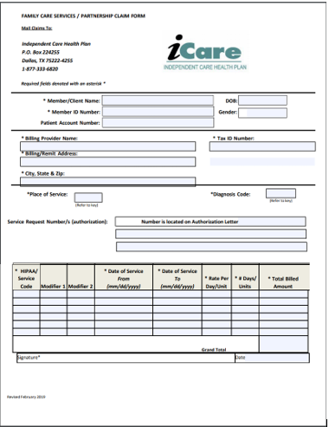
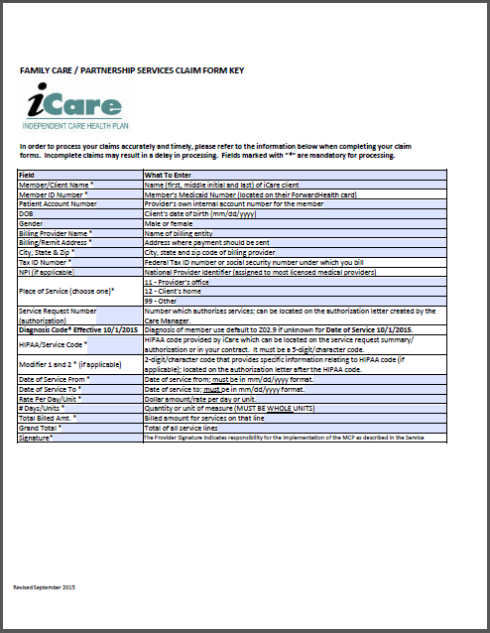
LTC Professional Claim Form www.icarehealthplan.org/providers

Slide 12
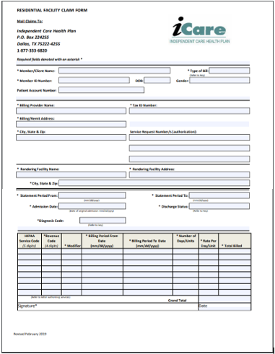
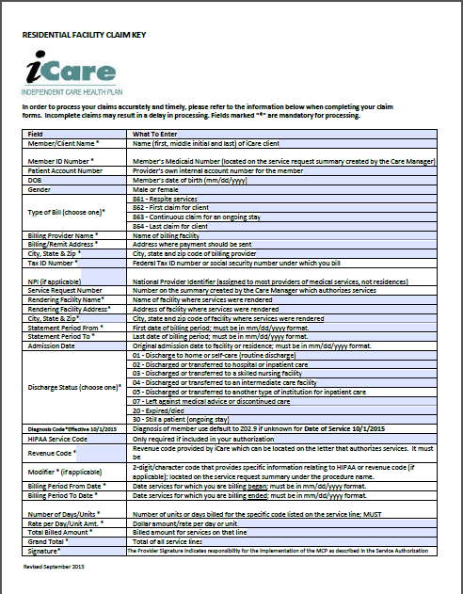
LTC Residential Claim Form www.icarehealthplan.org/providers

Slide 13
Claims Filing Limits
Timely filing limits for all providers is 120 days from the date of service, unless otherwise agreed upon and included in the Provider’s service agreement with iCare.
Providers are to submit all claims for services rendered where iCare Medicare is primary or iCare Medicaid is primary according to the terms of the contract. Timely filing limits apply to initial claim submissions, resubmissions and corrected claims.

Slide 14
Claims Submission
Medicare/Medicaid Covered Services
Independent Care Health Plan
P.O. Box 280
Glen Burnie, MD 21060-0280
Long-Term Care Services
Independent Care Health Plan
P.O. Box 670
Glen Burnie, MD 21060-0670
iCare is partner with the claims clearinghouse, SSI Claimsnet, to allow electronic claims submission.
To register with SSI Claimsnet for electronic claims submission via the Internet, click here. Select iCare in the payer drop down box on the registration form to avoid paying any set-up or submission fees for your iCare claims through SSI Claimsnet

Slide 15
Electronic Funds Transfer (EFT) and Electronic Remittance Advice (ERA)
iCare has joined the InstaMed Network to deliver your payments as free EFT and ERA’s.
Sign up now to receive iCare payments as direct deposits!
Providers who do not have a National Provider Identifier (NPI) should submit the Order Form – Payer Payments. Write “Provider does NOT have an NPI” and attach a copy of your most recent explanation of payment (EOP). Fax the form and supporting document/s to (877) 755-3392.
For tips on successful EFT enrollment, please see the check list.

Slide 16
Frequently Asked Questions
Do all LTC services require service request/authorization?
  Yes, Service Requests are required for all services and must be received before services are rendered.
Can LTC claims be submitted electronically?
  LTC Professional claims may be submitted through the provider portal. LTC Residential claims may NOT be submitted through the provider portal; rather mailed to our PO Box in Dallas, TX.
Why is my claim denying?
  Claims can deny for many reasons. It is very important to make sure that you are comparing the claim to the service request on file.
  Things to check on the service request are rate per day or rate per unit.
  Was the correct HCPCS/Revenue Code and modifier (if applicable) used?
  Is the date span within the service request timeframe?
  Do the claim’s line-item totals and grand total calculate?

Slide 17
iCare Provider Portal Access
Your time is valuable. iCare's Provider Portal allows you to view prior authorizations, service requests, verify eligibility and view claim information for the iCare members you serve.
Getting Started
Registration can be completed with information already at your disposal using your TIN (Tax ID Number), NPI and most recent check number. Use the Facility/Group name as listed on your Explanation of Payment. iCare can also generate a one-time PIN, you can request a one-time PIN via the request button below. If you have checks with more than 20 claims processed your will need to request a PIN to register.
If you do not receive your PIN, please contact iCare at ProviderRelationsSpecialist@iCareHealthPlan.org for additional assistance.
If an organization chooses to assign roles for the employees, the Office Manager will need to create a user account for the users within your organization. Office Managers can set up additional users individually and invite them to register or you can create user accounts in bulk via spreadsheet upload.
The iCare Portal User Guide provides step by step instructions for registration and outlines functionalities. If you have any questions, please contact ProviderOutreach@iCareHealthPlan.org or ProviderRelationsSpecialist@iCareHealthPlan.org
Use care when entering your password in the Provider Portal. If the incorrect password is attempted 3 times, your account will be locked. If you are not able to reset your own password or retrieve your forgotten password, email ProviderOutreach@iCareHealthPlan.org or ProviderRelationsSpecialist@iCareHealthPlan.org. Include your Username and your password will be reset within 24 hours.

Slide 18
iCare Contact Information
Customer Service-Milwaukee Office
(Monday-Friday 8:00-5:00)
Provider Local: 414-231-1029
Out of Area: 1/877-333-6820
Email: department-providerservices@icarehealthplan.org
iCare Dane County Office
1-800-777-4376
Prior Authorization
Local: 414-299-5539
Out of Area: 855-839-1032
Fax: 414-231-1026
Interdisciplinary Team
414-231-4847
Member Rights Specialist
414-231-1076
Fax: 414-231-1026
Pharmacy
1-800-910-4743
1-877-333-6820
Provider Contracting
414-225-4741
FAX: 414-272-5618

