Slide 1

iCare Guide for Physical, Occupational and Speech Therapy
Claims Processing Overview

Slide 2
Disclaimer
This information is provided as a courtesy from iCare to assist you with claims submission and billing. This does not replace Forward Health and CMS Guidelines. iCare relies upon Forward Health and CMS for payment rules and regulations for claim submission.

Slide 3
Abbreviations
Abbreviations
  PT – Physical Therapy
  OT – Occupational Therapy
  SLP – Speech, Language and Pathology Therapy
  PA – Prior Authorization

Slide 4
PT, OT and ST – Prior Authorization
Prior Authorization is required for ALL outpatient therapy services including PT, OT and SLP.
iCare authorizes outpatient therapy by number of visits; however, the CPT codes that the provider anticipates billing MUST be listed on the prior authorization request form in order to complete the clinical review and determine medical necessity.
Comprehensive information about the member helps to establish the functional potential of the member and forms the basis for determining whether the member will benefit from the requested services. Please submit the Prior Authorization Request form along with the completed therapy evaluation, plan of care, and signed physicians prescription for review to determine if the service is medically necessary.
Outpatient therapy will be authorized based on medical necessity. Services that are medically necessary are defined under Wis. Admin. Code § DHS 101.03(96m). The provider is responsible to assure that the services provided are covered under the Medicare or Medicaid benefit, whichever applies.

Slide 5
PT, OT and ST – Prior Authorization
An approved PA request will be backdated to the initial date of the evaluation if the PA request is received within 14 calendar days of the initial therapy evaluation. iCare will not retro authorize any authorization requests submitted beyond the 14 calendar days of the initial evaluation.
Continuing therapy requests may be requested when the member's need for therapy services is expected to exceed the maximum allowable treatment days authorized.
For continuing therapy requests, prior authorization must be obtained. PA requests for ongoing therapy will not be backdated. To request additional visits, please submit the completed Prior Authorization Request form, as well as clinical documentation to support medical necessity for ongoing therapy services.

Slide 6
PT, OT and ST – Prior Authorization
PA requests are approved for varying periods of time based on the clinical justification submitted. The provider receives a copy of a PA decision notice when a PA request for a service is approved. Providers may then begin providing the approved service on the start date given.
An approved request means that the requested service, not necessarily by code, was approved. Providers are encouraged to review approved PA requests to confirm the services authorized and confirm the assigned start and end dates.
All claims for services are subject to the coverage and medical necessity guidelines provided by Medicare and Medicaid.
Medicare Guidelines for Outpatient Physical and Occupational Therapy Services can be found here.
Medical Guidelines can be found here.

Slide 7
Therapy Codes and Modifiers
CPT codes are required on all outpatient therapy claims submitted on the CMS 1500 claim form.
  Claims or adjustments received without a valid CPT code will be rejected
CMS and ForwardHealth websites have all applicable CPT codes and modifiers for all therapy codes.
  CMS - https://www.cms.gov/medicare/medicare.html
  ForwardHealth https://www.forwardhealth.wi.gov/WIPortal/
    Please access ForwardHealth’s online handbook for detailed Therapy information.

Slide 8
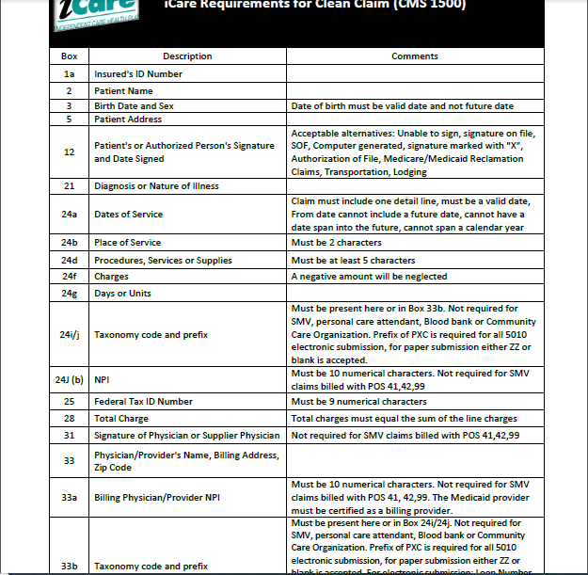
Clean Claim Guidelines
CMS 1500

Slide 9
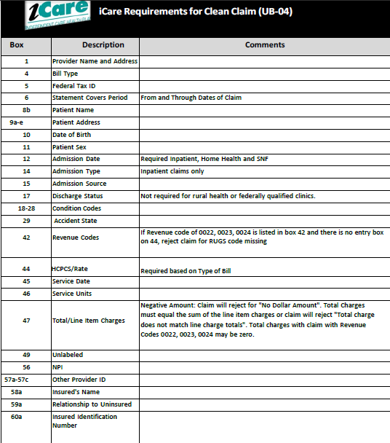
Clean Claim Guidelines
UB04

Slide 10
Claims Filing Limits
Timely filing limits for all providers is 120 days from the date of service, unless otherwise agreed upon and included in the Provider’s service agreement with iCare.
Providers are to submit all claims for services rendered where iCare Medicare is primary or iCare Medicaid is primary according to the terms of the contract. Timely filing limits apply to initial claim submissions, resubmissions and corrected claims.

Slide 11
Claims Submission
Medicare/Medicaid Covered Services
Independent Care Health Plan
P.O. Box 280
Glen Burnie, MD 21061-0280
Long-Term Care Services
Independent Care Health Plan
P.O. Box 670
Glen Burnie, MD 21061-0670
iCare is partner with the claims clearinghouse, SSI Claimsnet, to allow electronic claims submission.
To register with SSI Claimsnet for electronic claims submission via the Internet, click here. Select iCare in the payer drop down box on the registration form to avoid paying any set-up or submission fees for your iCare claims through SSI Claimsnet

Slide 12
iCare Provider Portal Access
Your time is valuable. iCare's Provider Portal allows you to view prior authorizations, service requests, verify eligibility and view claim information for the iCare members you serve.
Getting Started
Registration can be completed with information already at your disposal using your TIN (Tax ID Number), NPI and most recent check number. Use the Facility/Group name as listed on your Explanation of Payment. iCare can also generate a one-time PIN, you can request a one-time PIN via the request button below. If you have checks with more than 20 claims processed your will need to request a PIN to register.
If you do not receive your PIN, please contact iCare at ProviderRelationsSpecialist@iCareHealthPlan.org for additional assistance.
If an organization chooses to assign roles for the employees, the Office Manager will need to create a user account for the users within your organization. Office Managers can set up additional users individually and invite them to register or you can create user accounts in bulk via spreadsheet upload.
The iCare Portal User Guide provides step by step instructions for registration and outlines functionalities. If you have any questions, please contact ProviderOutreach@iCareHealthPlan.org or ProviderRelationsSpecialist@iCareHealthPlan.org
Use care when entering your password in the Provider Portal. If the incorrect password is attempted 3 times, your account will be locked. If you are not able to reset your own password or retrieve your forgotten password, email ProviderOutreach@iCareHealthPlan.org or ProviderRelationsSpecialist@iCareHealthPlan.org. Include your Username and your password will be reset within 24 hours.

Slide 13
Electronic Funds Transfer (EFT) and Electronic Remittance Advice (ERA)
Electronic Funds Transfer (EFT) EnrollmentiCare has joined the InstaMed Network to deliver your payments as free electronic remittance advice (ERA) and electronic funds transfer (EFT).
Sign up now to receive iCare payments as direct deposits!
ERA/EFT is a convenient, paperless and secure way to receive claims payments. Funds are deposited directly into your designated bank account and include the TRN Reassociation Trace Number in accordance with CAQH CORE Phase III Operating Rules for HIPAA standard transactions. Additional benefits include:
Accelerated access to funds with direct deposit into your existing bank account
Reduced administrative costs by eliminating paper checks and remittances
No disruption to your current workflow — ERAs can also be routed to your existing clearinghouse
You have two simple options to register for free ERA/EFT from InstaMed:
Online: visit www.instamed.com/eraeft
Phone: call us at (866) 945-7990 to speak with a live agent

Slide 14
Frequently Asked Questions
Q: When do I need an Authorization?
A: Prior authorization is required for all outpatient therapy services including PT, OT, and SLP
Q: Where can I find Prior Authorization and Outpatient Notification forms?
A: Prior authorization and outpatient notification forms are available on the iCare provider website at https://www.icarehealthplan.org/Forms/ProviderForms.aspx
Q: Does iCare offer electronic claims submission?
A: Yes, iCare offers electronic claims submission through Claimsnet. For more information please visit http://www.claimsnet.com/
Q: What is iCare’ Payer ID number for electronic claims?
A: iCare’s Payer ID number is 11695.
Q: What is the correct way to submit claims for a dual eligible member if I am a provider that is not Medicare certified?
A: An M8 disclaimer should be placed in Box 11 on a HCFA 1500. This is a code used when Medicare never covers the procedure in any circumstance, or the recipient’s Wisconsin Medicaid file shows he or she does not have any Medicare coverage for the services provided.

Slide 15
GENERAL CONTACT/INDIVIDUAL DEPARTMENT PHONE AND FAX NUMBERS
MAIN NUMBER
414-223-4847 or 800-777-4376
Claims/Appeals/Reconsiderations
Local: 414-231-1029
Fax: 414-231-1094
Out of Area: 877-333-6820
Email: providerservices@icarehealthplan.org
Eligibility and Provider Services
Local: 414-231-1029
Fax: 414-231-1094
Out of Area: 877-333-6820
Prior Authorization
Local: 414-299-5539
Out of Area: 855-839-1032
Fax: 414-231-1026
Provider Contracting
414-225-4741
Fax: 414-272-5618

