Slide 1

a Humana Inc, subsidiary
iCare Guide for Durable Medical Equipment (DME) and Disposable Medical Supplies (DMS)
CLAIMS PROCESSING OVERVIEW

Slide 2
Disclaimer:
This information is provided as a courtesy from iCare to assist you with claims submission and billing. This does not replace Forward Health and CMS Guidelines. iCare relies upon Forward Health and CMS for payment rules and regulations for claim submission.

Slide 3
DME & DMS – Medical Management
Prior Authorization is required for select durable medical equipment and supplies
For detailed procedure code specific information which require prior authorization, please reference the Prior Authorization Procedure Specific Listing. https://www.icarehealthplan.org/Providers/Authorization.aspx
Note: this list is updated on a quarterly basis. Please check the date on the form to ensure you are referencing the most up to date version.

Slide 4
DME & DMS – Medical Management Cont.
Prior Authorization request form: https://www.icarehealthplan.org/Forms/ProviderForms.aspx
Please note that supporting clinical documentation is required for all prior authorization requests in order to determine medical necessity. Incomplete prior authorization requests may delay processing. iCare will not retro authorize services rendered prior to the determination of a prior authorization

Slide 5
Medicare & Medicaid Coverage
Medically necessary durable medical equipment a doctor prescribes for use in home. Only the doctor can prescribe medical equipment for a member.
DME criteria:
  Durable (long-lasting)
  Used for a medical reason
  Not usually useful to someone who isn't sick or injured
  Used in your home

Slide 6
Medicare Coverage
Medicare coverage includes, but is not limited to:
Blood sugar monitors
Blood sugar test strips
Canes
Commode chairs
Continuous passive motion devices
Continuous Positive Airway Pressure (CPAP) devices
Crutches
Hospital beds
Infusion pumps & supplies
Lancet devices & lancets
Nebulizers & nebulizer medications
Oxygen equipment & accessories
Patient lifts
Pressure-reducing beds, mattresses, and mattress overlays
Suction pumps
Traction equipment
Walkers
Wheelchairs & scooters

Slide 7
Medicaid Coverage
Medicaid coverage includes, but is not limited to:
Back-up or Secondary Durable Medical Equipment
Codes
Compression Garments
Covered Services and Requirements
Diabetic Supplies
HealthCheck "Other Services“
Home Health Equipment
Implants
Mobility Devices and Accessories
Noncovered Services
Nursing Home Members and Durable Medical Equipment
Oxygen and Respiratory Equipment
Prosthetic Procedures
Repair of Durable Medical Equipment

Slide 8
DME/DMS Frequently Asked Questions (FAQ)
How will Medicare pay for oxygen and oxygen equipment rental?
  Answer: Medicare payment for oxygen and oxygen equipment is made on a monthly basis. One bundled monthly payment amount is made for all covered stationary equipment, stationary and portable contents, and all accessories used in conjunction with the oxygen equipment. An add-on payment may also be made for those beneficiaries who require portable oxygen. Per the Medicare Improvements for Patients and Providers Act of 2008 (MIPPA), effective January 1, 2009, Medicare payment for oxygen equipment may not continue beyond 36 months of continuous use. After the 36 month rental cap, Medicare will continue to make monthly rental payments for oxygen contents. In addition, payment for in-home maintenance and servicing of supplier-owned oxygen concentrators and trans filling equipment will be made every 6 months, beginning 6 months after the rental cap, for any period of medical need for the remainder of the reasonable useful lifetime of the equipment. Payment is made on a monthly basis for oxygen contents for beneficiaries who own liquid or gaseous oxygen equipment.
2. For dual FCP members. Should I receive two prior authorizations for both lines of business (LOB)?
  Answer : No, you will only receive one authorization to support both LOBs and date range.
Note: For Traditional Medicare and Medicaid SSI member you will receive two authorizations. One for each line of business and date range.

Slide 9
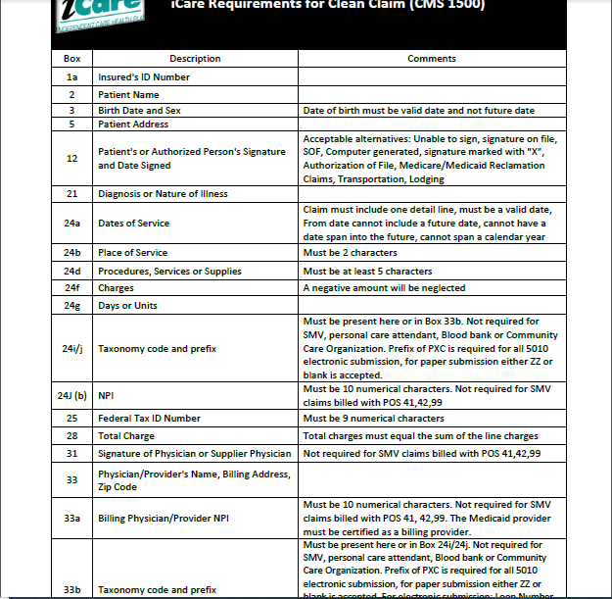
Clean Claim Guidelines

Slide 10
Claims Filing Limits
Timely filing limits for all providers is 120 days from the date of service, unless otherwise agreed upon and included in the Provider’s service agreement with iCare.
Providers are to submit all claims for services rendered where iCare Medicare is primary or iCare Medicaid is primary according to the terms of the contract. Timely filing limits apply to initial claim submissions, resubmissions and corrected claims.

Slide 11
Claims Submission
Medicare/Medicaid Covered Services
Independent Care Health Plan
P.O. Box 280
Glen Burnie, MD 21060-0280
Long-Term Care Services
Independent Care Health Plan
P.O. Box 670
Glen Burnie, MD 21060-0670
iCare is partner with the claims clearinghouse, SSI Claimsnet, to allow electronic claims submission.
To register with SSI Claimsnet for electronic claims submission via the Internet, click here. Select iCare in the payer drop down box on the registration form to avoid paying any set-up or submission fees for your iCare claims through SSI Claimsnet

Slide 12
Electronic Funds Transfer (EFT) and Electronic Remittance Advice (ERA)
Electronic Funds Transfer (EFT) EnrollmentiCare has joined the InstaMed Network to deliver your payments as free electronic remittance advice (ERA) and electronic funds transfer (EFT).
Sign up now to receive iCare payments as direct deposits!
ERA/EFT is a convenient, paperless and secure way to receive claims payments. Funds are deposited directly into your designated bank account and include the TRN Reassociation Trace Number in accordance with CAQH CORE Phase III Operating Rules for HIPAA standard transactions. Additional benefits include:
Accelerated access to funds with direct deposit into your existing bank account
Reduced administrative costs by eliminating paper checks and remittances
No disruption to your current workflow — ERAs can also be routed to your existing clearinghouse
You have two simple options to register for free ERA/EFT from InstaMed:
Online: visit www.instamed.com/eraeft
Phone: call us at (866) 945-7990 to speak with a live agent

Slide 13
For More Information:
ForwardHealth Website Link: https://www.forwardhealth.wi.gov/WIPortal/
CMS Website Link: https://www.cms.gov
ForwardHealth DME Handbook:
https://www.forwardhealth.wi.gov/WIPortal/Subsystem/KW/Display.aspx?ia=1&p=1&sa=17&s=9&c=50
Centers for Medicare and Medicaid Information:
https://www.medicare.gov/coverage/durable-medical-equipment-dme-coverage

Slide 14
iCare Provider Portal Access
Your time is valuable. iCare's Provider Portal allows you to view prior authorizations, service requests, verify eligibility and view claim information for the iCare members you serve.
Getting Started
Registration can be completed with information already at your disposal using your TIN (Tax ID Number), NPI and most recent check number. Use the Facility/Group name as listed on your Explanation of Payment. iCare can also generate a one-time PIN, you can request a one-time PIN via the request button below. If you have checks with more than 20 claims processed your will need to request a PIN to register.
If you do not receive your PIN, please contact iCare at ProviderRelationsSpecialist@iCareHealthPlan.org for additional assistance.
If an organization chooses to assign roles for the employees, the Office Manager will need to create a user account for the users within your organization. Office Managers can set up additional users individually and invite them to register or you can create user accounts in bulk via spreadsheet upload.
The iCare Portal User Guide provides step by step instructions for registration and outlines functionalities. If you have any questions, please contact ProviderOutreach@iCareHealthPlan.org or ProviderRelationsSpecialist@iCareHealthPlan.org
Use care when entering your password in the Provider Portal. If the incorrect password is attempted 3 times, your account will be locked. If you are not able to reset your own password or retrieve your forgotten password, email ProviderOutreach@iCareHealthPlan.org or ProviderRelationsSpecialist@iCareHealthPlan.org. Include your Username and your password will be reset within 24 hours.

Slide 15
iCare Contact Information
Customer Service-Milwaukee Office
(Monday-Friday 8:00-5:00)
Member Local: 414-223-4847
Out Of Area: 1-800-777-4376
Provider Local: 414-231-1029
Out of Area: 1/877-333-6820
Email: providerservices@icarehealthplan.org
iCare Dane County Office
1-800-777-4376
Inpatient Admissions Notification
414-225-4760
FAX: 414-231-1075
Interdisciplinary Team
414-231-4847
Member Rights Specialist
414-231-1076
Fax: 414-231-1026
Pharmacy
1-800-910-4743
1-877-333-6820
Provider Contracting
414-225-4741
FAX: 414-272-5618

