Slide 1
Model of Care Medicare, Medicaid SSI, BadgerCare+, Family Care Partnership
a Humana Inc, subsidiary

Slide 2
iCare Benefit Plans
Medicare – SNP
iCare Special Needs Plan
Medicaid – SSI
Medicaid - BadgerCare+
Family Care Partnership
It is essential as a provider that you verify a Member's eligibility, as it may change frequently
Check ForwardHealth & iCare eligibility via Customer Service or iCare Portal

Slide 3
iCare Model of Care
The iCare Medicare Plan is a Medicare Advantage program that offers health care benefits for all eligible Medicare beneficiaries with special needs.
iCare is a Coordinated Care plan with a Medicare contract and a contract with the State of Wisconsin Medicaid program.
iCare combines health care services provided by Medicaid and Medicare to offer members a complete package of benefits, including the Medicare Part D Prescription Drug program.
iCare acts as a partner to complement the efforts of its physicians, hospitals, and ancillary providers to achieve the following goals

Slide 4
iCare’s Goals
Improve healthcare access for our Members
Improve health outcomes and quality of life for our Members
Improve communication together with Members and stakeholders
Providers including Physicians, Nurses, Therapists and administrative staff
HealthCare Facilities
Home caregiver
Personal care workers
Family and Friends
The MEMBER
Manage healthcare costs

Slide 5
Achieving our goals together
Conducting a comprehensive assessment to identify the Members Medical, Behavioral and Social needs
Creating a dynamic care plan with the Member
Monitoring Member progress towards their goals
Identifying resources available to meet the Members needs
Coordinating service provisions
Assisting Members with accessing services
Working to promote behavioral change and self empowerment within our Members
Implementing quality improvement initiatives and so much more!!

Slide 6
Who we serve

Slide 7
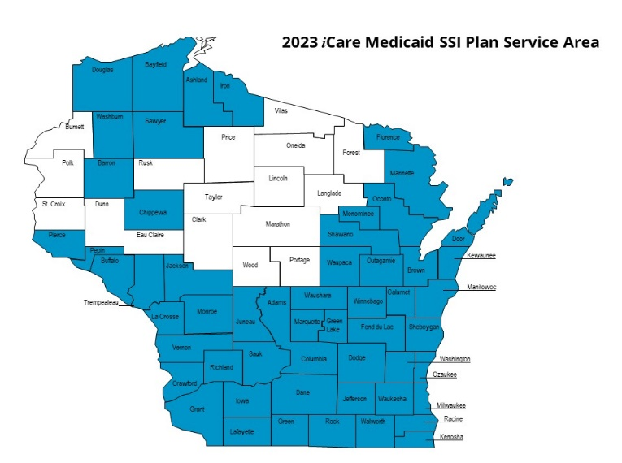
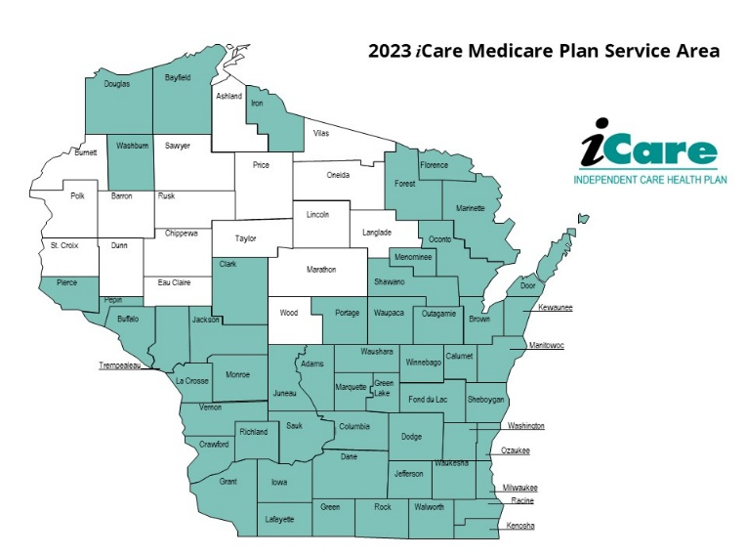
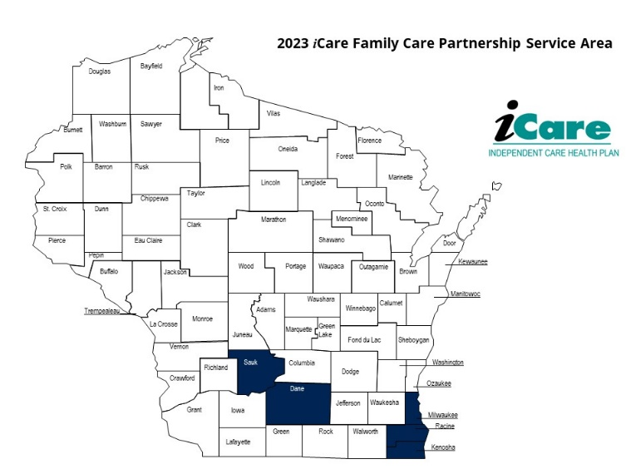
Where are members are

Slide 8
Description of our population
Low socioeconomic status
Low health literacy
Disabilities including mental health and substance abuse challenges
Unstable housing
Co-morbidities including serious health challenges such as diabetes, COPD, Cardiovascular Disease and others

Slide 9
iCare Member Demographics
Race/Ethnicity
40% White
30% Black
13% Hispanic
<5% Other
Language
68% Unknown
24% English
5.45% Spanish
> 1% Other
Age
0-19 26%
20-40 31%
41-64 29%
65+ 13%
As reported by the Members

Slide 10
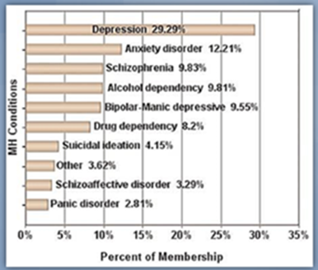
Vulnerable Members – iCare Member Demographics
Behavioral and Mental Health needs of iCare’s Membership

Slide 11
Wisconsin Health Determinants

Slide 12
1 in 5 Medicare patients are readmitted to a hospital within 30 days of discharge
Medication discrepancies
NOTE: Providers should complete a Medication Reconciliation will all Members Post-Hospitalization Discharge/Follow-up within 30 days
Discharge instructions/order confusion
Social determinants
Lack of home support
Provider follow-up appointments
NOTE: Providers are strongly encouraged to verify Member Hospitalizations within the past 30 days

Slide 13
Medicare SNP Care Coordination
iCare’s Medicare Plan is a Medicare Advantage program that offers health care benefits for all eligible Medicare beneficiaries with special needs
iCare covers everything that original Medicare covers
iCare also covers Part D drugs, and Part B drugs such as chemotherapy drugs and some drugs administered by the provider
Essential elements of Care Coordination SNP
Initial & Annual Health Risk Assessments (HRA)
Individualized Care Plan (ICP)
Interdisciplinary Care Team (ICT)
Monitoring Acute Changes in Condition
Managing Transitions in care
Work with Member’s Healthcare providers to maintain Member wellness
iCare Team
Care Coordinators
RN’s

Slide 14
SNP Care Transitions
During transition of care, iCare SNP Care Management team is available to:
Provide/reinforce education to members
Coordinate follow-up appointments
Ensure member’s understand post-discharge plan
Support caregivers
Update individualized Care Plan and share with primary provider
Engage and coordinate with other key participants in the interdisciplinary care team

Slide 15
SNP Enhanced Benefits
Healthy Options Allowance
Hearing Benefit – NEW for 2024
Non-Emergency Transportation
Prescription Drug Benefit
Dental
Vision
Silver Sneakers Fitness
Acupuncture
Meals
Wellness and Health Care Planning
24/7 Nurse Advice Line
iCare Medicare Plan (icarehealthplan.org)
*Enhanced benefit availability should be verified with iCare prior to rendering service

Slide 16
Medicaid – SSI Care Coordination
An iCare expert team with varied educational and work experience is assigned to each member, who receive a comprehensive assessment, care plan, care coordination and case management services
Essential Elements of Care Coordination
Initial & Annual HRA’s
Individualized Care Plan (ICP)
Communicate regularly with providers; Updates and/or modifications to the ICP as needed
Managing transitions in care
Monitoring acute change(s) in condition
Intervention specialist for high needs
Community Health Worker
iCare Team
Care Coordinator
Care Manager
RN

Slide 17
SSI – Enhanced Benefits
Gym Membership

Slide 18
BadgerCare +
Childless adults up to 64 years of age (CLA)
Mother and child (MCH)
Includes caretaker
Essential elements of Care Coordination
Initial Health Needs Assessment (HNA)
Monitoring care and promoting preventive screenings
Access to appropriate medical and behavioral care and resources
Establishing desired outcomes and following up
Complete prenatal/post-partum assessments
Cross coverage for Mom & Baby program
with BC+
iCare Team
Care Coordinator
Care Manager
RN

Slide 19
Family Care Partnership (FCP)
Health and Long-Term Care (LTC) program that fully integrates all aspects of a Member’s care
Designed to meet the LTC needs of frail older adults and people with physical and/or developmental disabilities
Goal to help Members maintain their independence within the community setting working in collaboration with the PCP provider for home and community based LTC services
iCare Interdisciplinary Team
Nurse Practitioner
RN
CM

Slide 20
FCP Benefits
iCare FCP covers Medicare, Wisconsin Medicaid, and home and community-based LTC services
Services support the member’s best possible functioning in the least restrictive setting
Member centric approach emphasizes services provided in the location desired by the member by the providers desired by the member and embodies the needs of choice and autonomy and independence

Slide 21
FCP Enhanced Benefits
Dental
Vision
Hearing (TruHearing)
Acupuncture for Low Back Pain
Healthy Options Allowance to spend at participating retailers towards purchase of OTC products, healthy foods or personal or home products and services
Enhanced benefit availability should be verified with iCare prior to rendering service

Slide 22
CMS 5 Star Measures
Medicare (Special Needs Plan and Family Care Partnership)
Preventive Screens (HEDIS)
Testing/Control
Follow-up Appointments
Member Satisfaction
Member Education

Slide 23
DHS Pay for Performance (P4P)
SSI and BadgerCare+
Preventive screening
Testing/Control
Follow-up Appointments
Member Satisfaction
Member Education

Slide 24
Provider Education Responsibilities
Annually review iCare Model of Care training
Provider information can be found on our website
Education>Resources>Model of Care

Slide 25
Thank you!
Please contact us with any questions:
Customer Service – 1-800-777-4376

